Slide 1
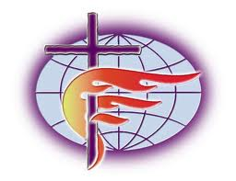
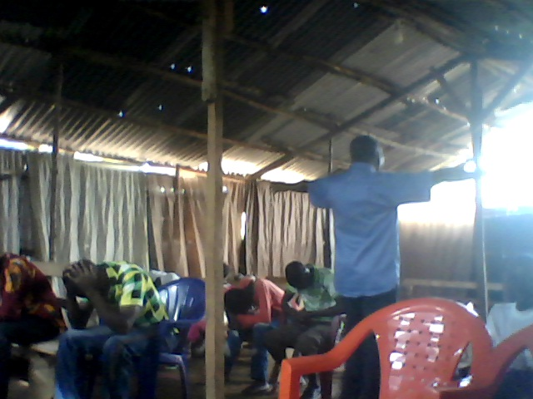
FREE METHODIST CHURCH OF GUINEA
CHURCH EXPANSION PROGRAM

Slide 2
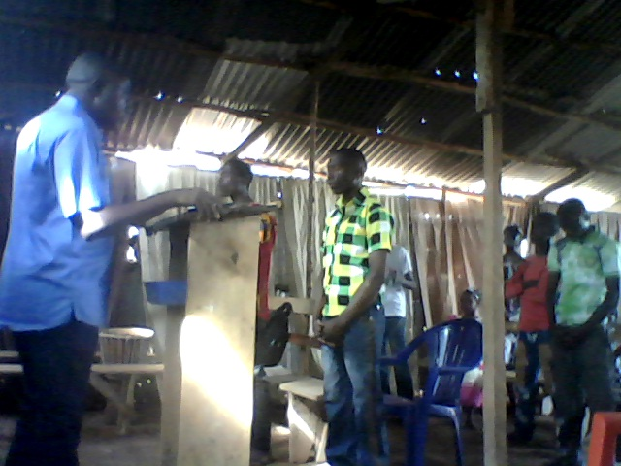
FREE METHODIST CHURCH OF GUINEA
CONTENT
1-PRESENTATION OF THE CHURCH
2-CHURCH ACTIVITIES
3-CHURCH EXPANSION PROGRAM
3°1)- HEADQUATER AND BRANCHES BUILDING PROJECT
3°2) CHILDCARE PROGRAM
3°3) SELF HELP PROGRAM FOR BELIVERS

Slide 3
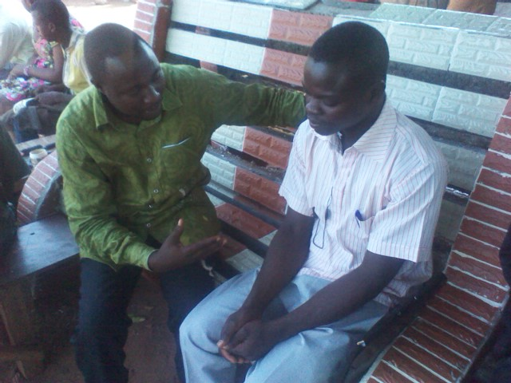
FREE METHODIST CHURCH OF GUINEA
PRESENTATION OF THE CHURCH
The Free Methodist Church GUINEA ( MLG ) is an emerging branch of the Free Methodist Church of America practicing his faith and religious activities in Guinea under the doctrine and the profession of faith of Methodists in America. . MLG obey the great commission that the Lord Jesus Christ has commissioned us to go around the world and make all nations disciples of Christ. Free Methodists Guinea conscious of the need for a new evangelization in Africa and Guinea is committed to proclaiming the good news of the kingdom for the salvation of souls and contribute significantly to the growth and well being of his followers. The vision of Free Methodist Guinea is summarized in the following points:
The good news of the kingdom in Guinea
.Establish churches in the territory of Guinea.
Evangelizing unreached peoples
Build social infrastructure ( primary schools , training centers , clinics, hospitals,
orphanages, schools and colleges ......)
Contribute significantly to the development of communities in which it operates. ( Agro-pastoral, activities, fight against poverty and idleness . )
MLG The church is approved and recognized by the Guinean authorities under No. .233/MATD/CAB/DNLPR/2013 as a religious association with the objectives to achieve its expansion and conversion program for new believers. Evangelical field of Free Methodist of Guinea covers the towns of Kissidougou , Macenta and Yendé in Forestry regions . Among the faithful of the church is youth, women and children in large numbers. The Free Methodist Guinea are installed in a makeshift shed in the neighborhood FOULA MADINA in Conakry Ratoma council in Republic of Guinea under the leadership of Pastor BELLE Y MESSA MUKA of the Democratic Republic of Congo.

Slide 4
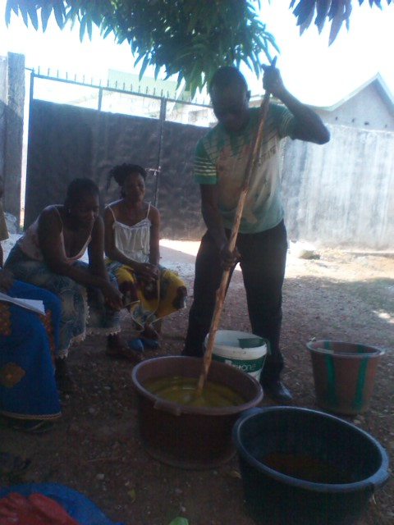
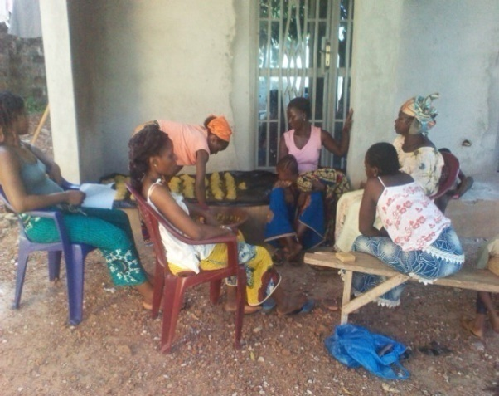
FREE METHODIST CHURCH OF GUINEA
2 - THE ACTIVITIES OF THE CHURCH
Regular activities of the Free Methodist Church of Guinea are :
-The practice of Sunday worship
-evangelism
-Social and humanitarian works
-The church planting
SUNDAY and WORSHIP PROGRAMS IN WEEKS ;
It takes place every Sunday from 9 AM until 12 : 00 and includes the following joints :
The Bible study .
First offering on Sunday.
The prayers of intercession for the community and nation .
Praise and worship
preaching
Second offering and dimes .
End of worship.
WEDNESDAYS FOR BIBLE STUDY.
Friday for the intercession sessions .
2-2 EVANGELISM
Evangelism is an ongoing activity of MLG . To achieve this goal , the church focuses on training and involvement of workers and laity of the church in the Biblical teaching in vernacular languages. MLG also works with Campus for Christ in the context of the film JESUS ​​translated into several local languages ​​of Guinea.
2-3 HUMANITARIAN ACTIVITIES
Faced with growing poverty and insecurity of the faithful, the MLG are also involved in social and humanitarian work in the communities where exercising the ministry . MLG work by training women in economic activities and trades training for young people. Early childhood is also a target population that the church wants to achieve. To do so, the church is working on emotional and spiritual care of children .
2-4 CHURCH PLANTING
The primary mission remains MLG church planting . The central church of Conakry works with independent pastors to increase its workforce and its pastors for its geographical and numerical extension.

Slide 5
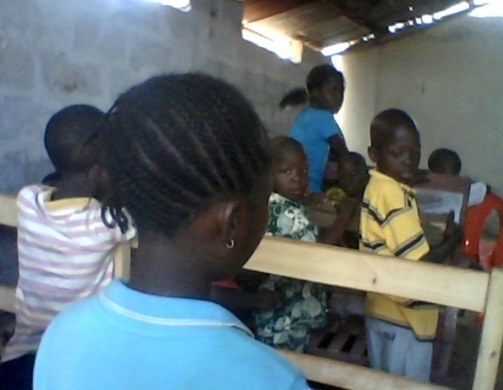
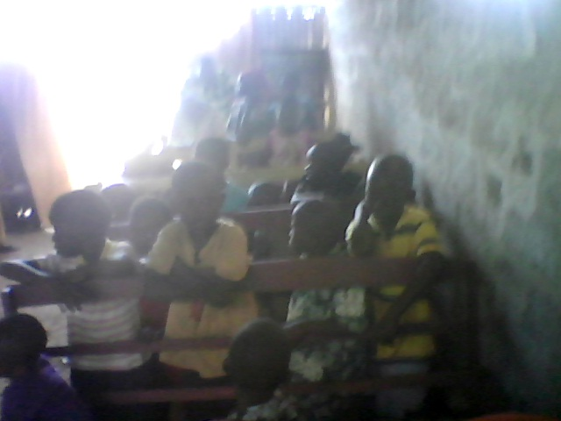
FREE METHODIST CHURCH OF GUINEA
CHURCH EXPANSION PROGRAM
The greatest current concern MLG is the consolidation of church activities in Guinea. The church relies on the intervention of the Lord for its rapid expansion in Guinea . The ultimate goal is to see Free Methodist branches in Guinea, Guinea Forestry , in Upper Guinea and Lower Guinea . The country is predominantly Muslim , the orientation of the church is to explore new fields with active workers to enable the vision of the church to incarnate and become an integral part of the body of Christ in Guinea. The main programs that the church wants to implement are :
The construction project of the Church of Conakry
The promotion and supervision of young Christian childhood program.
SELF HELP program for the promotion of the faithful of the Church.
The three main programs are guidelines objectives in the medium term by the church. Free Methodists of Guinea does not yet have a place of worship worthy of the name . Sunday worship is held in a shelter in old sheets, table and benches or without windows or doors. However , the church was able to gather the faithful among them many children. In addition many of the faithful that has the church are youth and women who may not have a comfortable social situation. for better supervision of these groups , the church plans to develop a holistic program to find a real impact in the lives of the faithful. This program will pass through capacity building and support for a better future self as new born

Slide 6
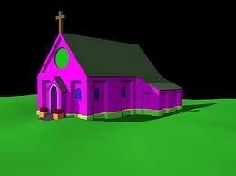
FREE METHODIST CHURCH OF GUINEA
HEADQUATER AND BRANCHES BUILDING PROGRAM
DESCRIPTION
The central church of MLG is a set of infrastructure to be built on an area to search by the Church of Conakry. This set of buildings will allow the mission to be installed on a site and organize these activities in terms of evangelism , education , health and humanitarian works . The project comes in the mind of the church to provide a building and establish the foundations of a Methodist mission whose vision is to invest for the salvation of souls in Guinea and contribute through its social work development of Guinea. The Church will consist of the following facilities:
A Methodist church for Bible study and Sunday worship.
Housing for pastors and teachers
A primary school
an orphanage
clinic
The project will be the implementation of the statutory mission of the Free Methodist Church of Guinea which is the name of a committed spiritual and social .

Slide 7
FREE METHODIST CHURCH OF GUINEA
CHILDCARE PROGRAM
One of the features of Free Methodist Guinea is the presence of many children. This gives an orientation of the vocation of the church which is to take care of children. Early childhood is a sensitive layer that we must supervise, educate, teach and protect. The innocence reflected by children is an opportunity for the church to have in reserve a faithful workers who will become the body of Christ in Guinea. Program promoting early childhood is therefore to :
Develop Christian socio -educational and health infrastructure for the development of early childhood among other kindergartens, orphanages , kindergartens, early learning centers and nutrition for toddlers .
The educational care for children from the poorest families.
Setting execution of evangelization programs, protection and spiritual formation of children.
Gifts and clothing items for children.
Catch in medical expenses in cases of health concern for children abandoned by their families.
The construction of primary schools , colleges and universities Methodist in Guinea .
This whole program focuses mainly on the level of education. The latter being a crucial factor in development for every human being , Free Methodists of Guinea will focus to impact all of its fields by Christian missionaries quality education regarding early childhood and youth. The program now requires support and participation of all people of good will and Christian organizations.

Slide 8
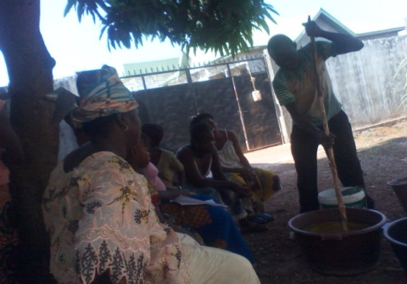
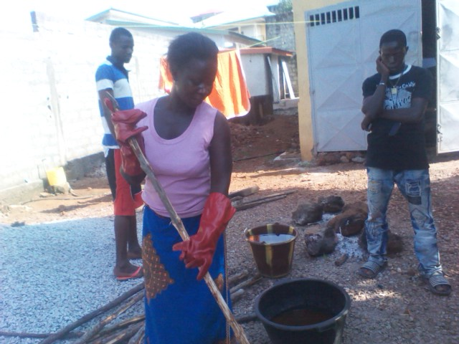
FREE METHODIST CHURCH OF GUINEA
SELF HELP PROGRAM FOR BELIVERS
One of the ongoing activities of the Free Methodist Church outside Guinea care on infant and child layer is SELF HELP program for the promotion of the faithful. Sometimes our mission fields are characterized by idle people , desperate and poor who survive on a daily basis . Free Methodists of Guinea have effectively handle it through the word of God and holistic evangelization , get out from poverty in all its forms , which is moral , physical , financial . By applying spiritual teaching , the biblical principles of entrepreneurship and individual decision charge of oneself through personal initiatives.
SELF HELP program for the promotion of true aims primarily to promote the initiative and the spirit of self help to deliver God's people poverty.
The program will promote the following activities:
Training in individual entrepreneurship
The income generating activities
Promotion of Christian groups .
Agriculture and farming community .
Community fields.
SELF HELP program regularly produces traditional soap by saponification techniques that women of the Church of Conakry organized regularly. This program also needs the support of partners to introduce women to the use of computers and microcredit management . Based on the scriptures , this program will benefit teach the faithful to the principles of biblical prosperity demonstrating the potential for success as a Christian .

