Slide 1

BI- ANNUAL REPORT(MAY – OCT) 2020
BY: WAMALA STEVEN
BLCDF ADMIN.
wamalastevenmukisa@gmail.com

Slide 2
overview
Barnabas Legacy Children’s Dream Foundation is a Christian NGO established in 2013 as God’s Vine International, though re-structured and registered fully in 2020. It’s location is in Buikwe district, Katunda village in Najjembe Sub-County.
BLCDF has grown beyond “a home for children and babies and now includes community programs under the Katunda PAOG Deborah Women in Business Collective through the infant and elderly feeding programs, scholarship programs, discipleship & parenting trainings, farming, and economic empowerment.
BLCDFs source of funding is mainly by individual families and churches in the Australia. Local funding is mobilized through large scale onsite projects .i.e. vegetables, beans, maize and other micro-garden growing.

Slide 3
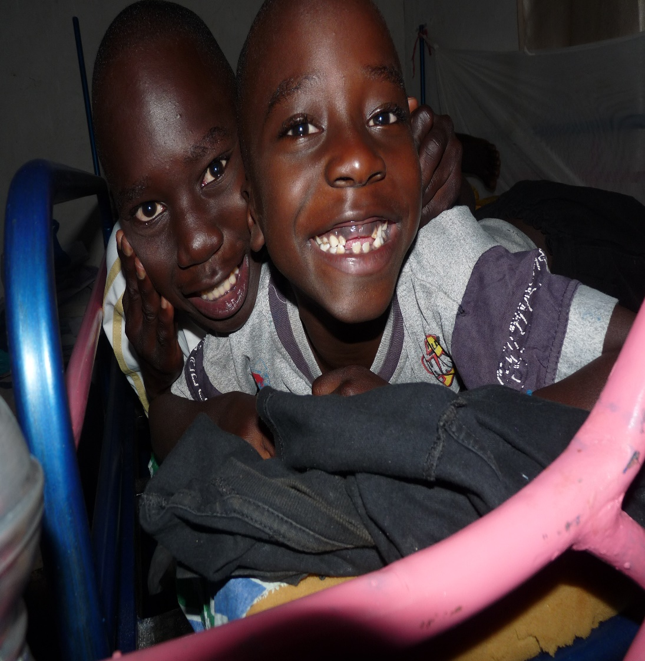
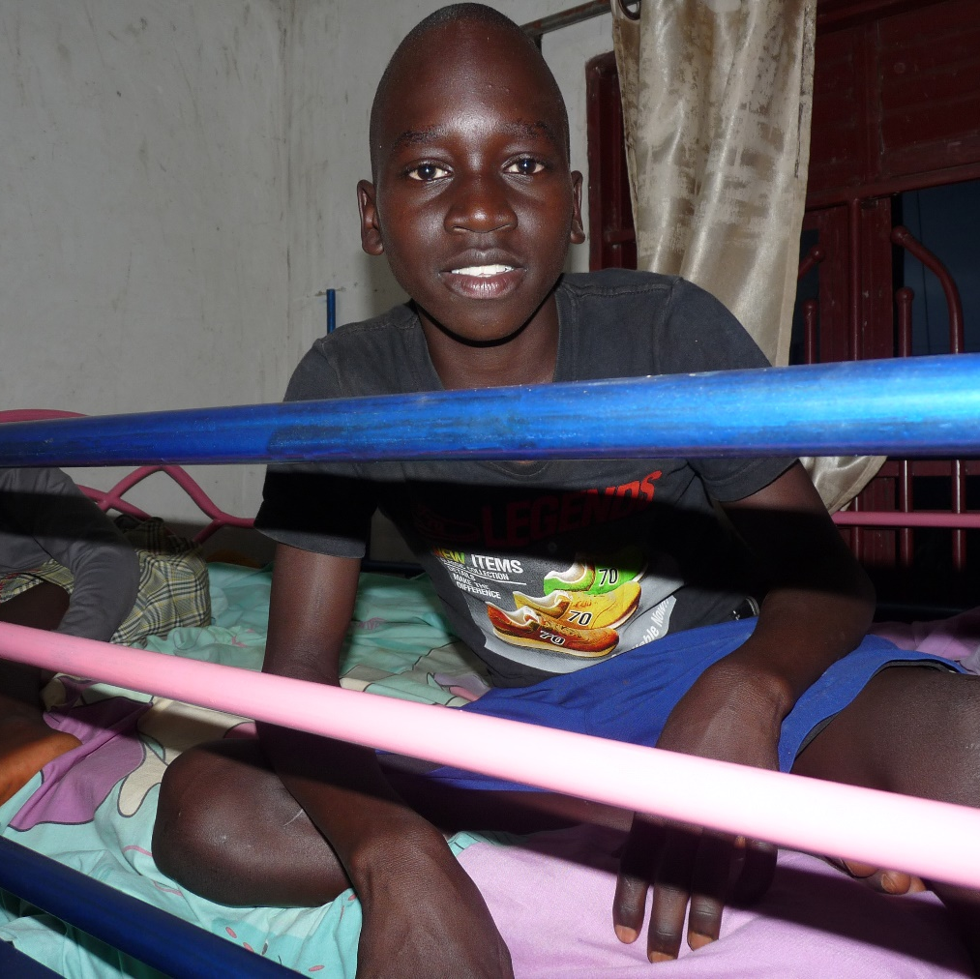
MISSION STATEMENT
Is to holistically build thriving families through child care , advocacy, education, and community development so that disciples are being made and communities are being transformed for Christ”.
ISAIAH 40:26
VISION STATEMENT
Making Disciples, Impacting the World for Christ

Slide 4
Scope of work
AREA OF OPERATION
BLCDF Operates in Central and Eastern Parts of Uganda and Particularly in 9 sub counties, namely;
Najjembe Ssii
Buikwe T/C Ngogwe
Nyenga Njeru
Wakisi Najja
BLCDF however mainly operates in Najjembe and Nyenga sub county for community programmes.

Slide 5
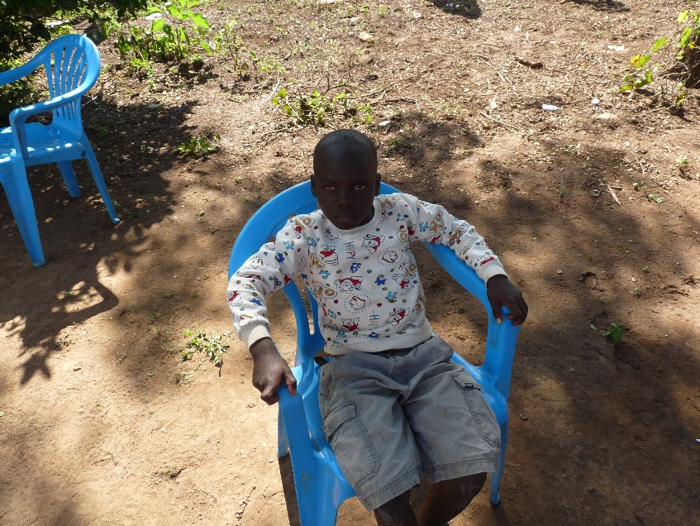
Category of beneficiaries
OVCs;
Who have lost parental care
Malnourished
With special needs
With Educational needs
Pictured is an OVC born with one EYE defection in BULANGIRA Pulaka Village

Slide 6
KEY MINISTRY AREAS
Core program areas
CHILD CARE
EDUCATION
COMMUNITY DEVELOPMENT
ADVOCACY
EDUCATION
FOOD & NUTRITION
ECONOMIC STRENGTHENING
HEALTH & SANITATION
CHILD PROTECTION

Slide 7
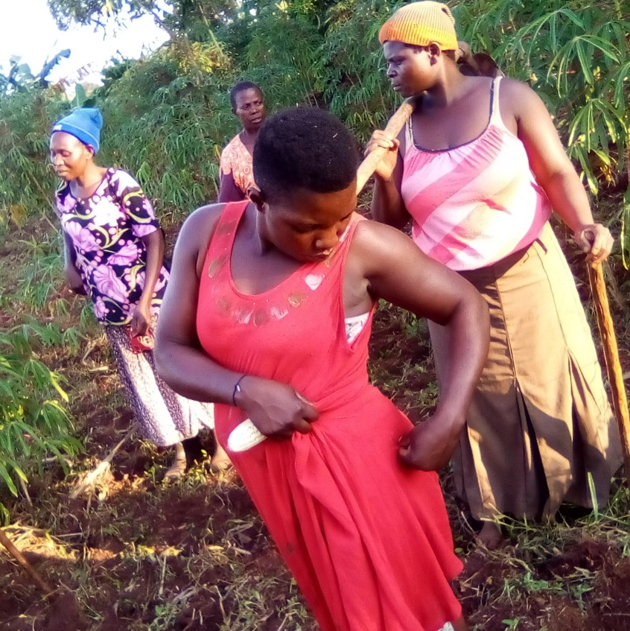
Community ECONOMIC STRENTHENING
Over 200 women benefitted from the Deborah Women Foundation and Gardening Program for economic strengthening through; Business skills training, financial literacy classes, start up kits, assistance with capital and gardening groups etc.
Tailoring school/center starts next year in March.
Pictured is a DWIB Church Women Beneficiary posing after a days gardening program.

Slide 8
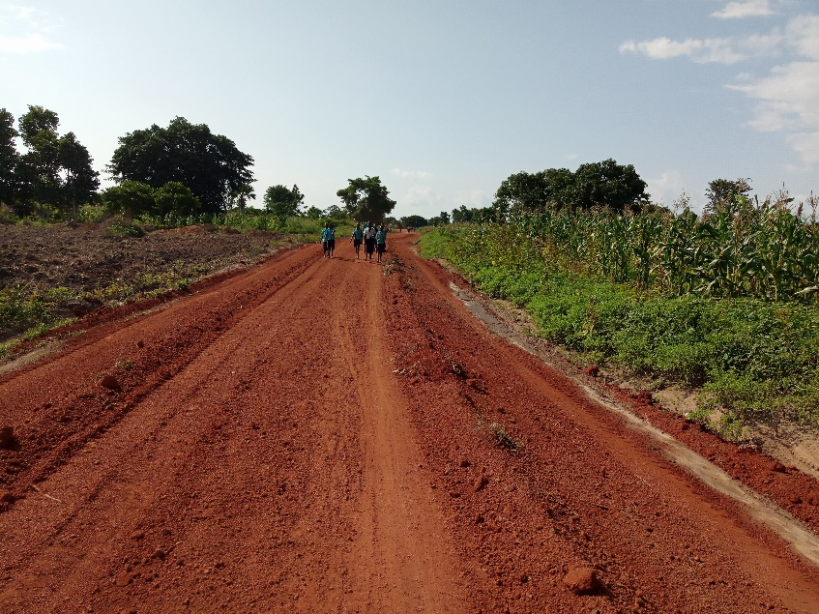
EDUCATION
This includes provision of scholastic materials, fees and uniforms to OVCs.
Over 250 children/OVCs are under our program to be supported to access education through the BLCDF primary school (for the start), Village scholarship program & Sponsorship.
We believe that many neglected children will graduate from university and get employed.
250 of the children under the sponsorship program are to be fed by the foundation under a given school -every day
A pioneer adult literacy program for OVC caregivers is to be started in 2021. Its curriculum will be comprehensive addressing, positive parenting, agricultural skills, financial literacy and basic academic knowledge
Pictured are children under the BLCDF program walking from school in the deep villages- some two years ago.

Slide 9
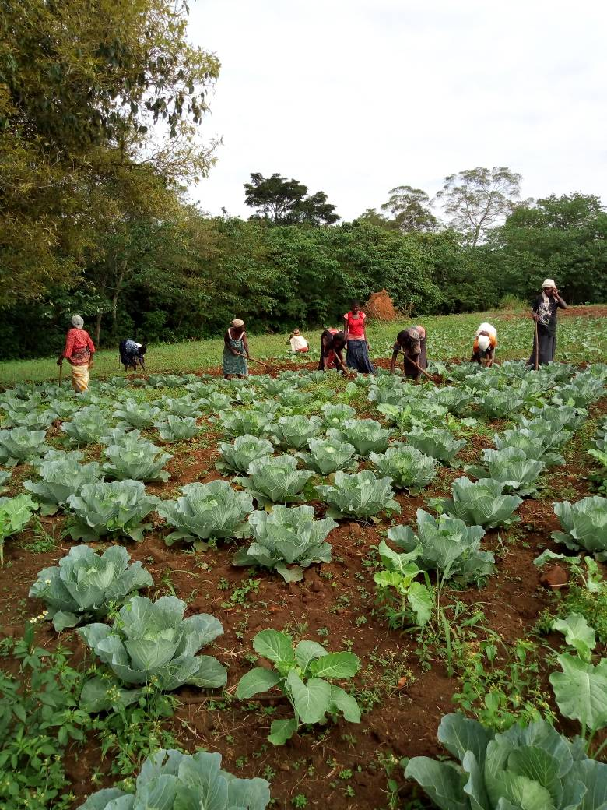
Food and nutrition
32 OVCs benefitted from nutritional support (Supplements & trainings)
23 Households with Elderly persons caring for OVCs in their care were provided with food aid.
OVC households are supported to make backyard gardens
Through a site demonstration garden, OVC households learn good farming practices.
Caregivers of OVCs weeding one of their demo Vegetable gardens

Slide 10
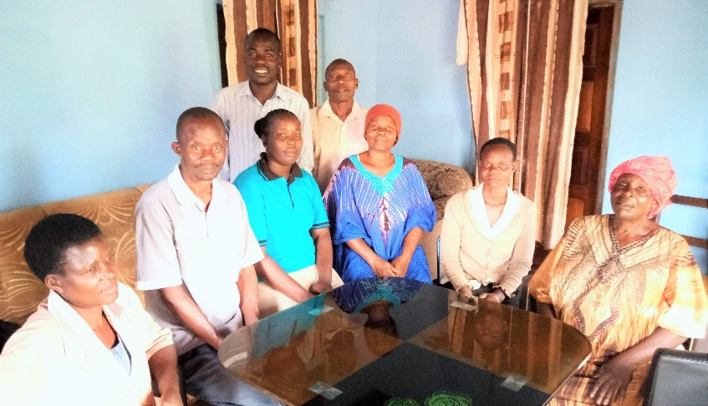
Child protection
Local leaders meetings, Parents meetings and school debates have intentionally integrated child protection topics in discussions.
Children with disability are supported to access therapy and devices to live normally.
Children are assisted to seek for justice and withdrawn from child abuse.
Children are re-united with their families
Leaders in session at BLCDF.

Slide 11
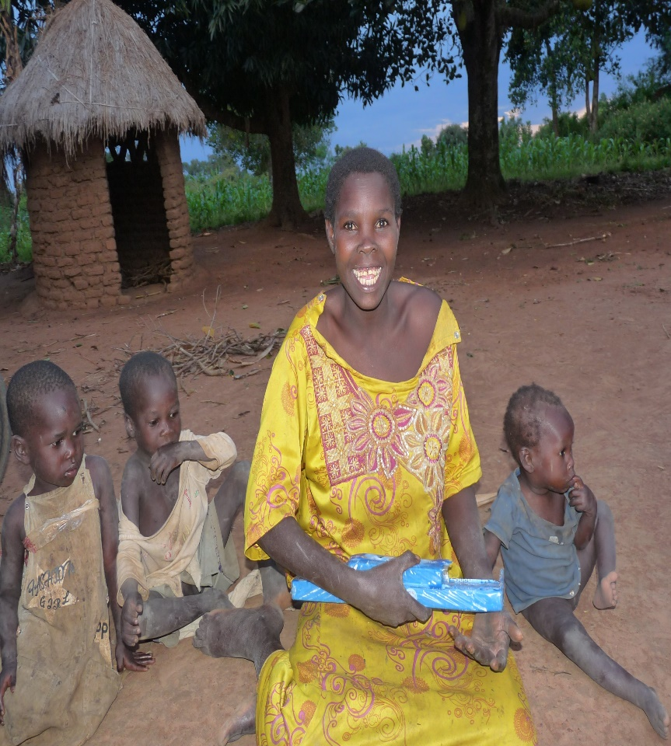
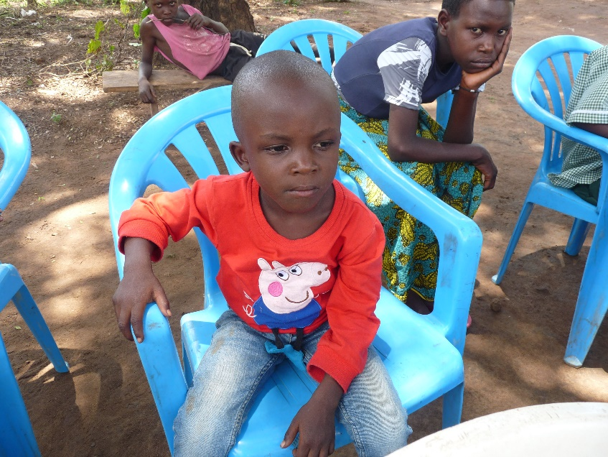
BLCDF provides services to OVCs with disability in residence and from the community through its qualified special needs staff of therapists.
A baby from institutional care reunified with his family. children are reintegrated with their families after a comprehensive approach of intervention to ensure safety and wellbeing.
A disabled MOTHER with her children and family in Bulangira

Slide 12
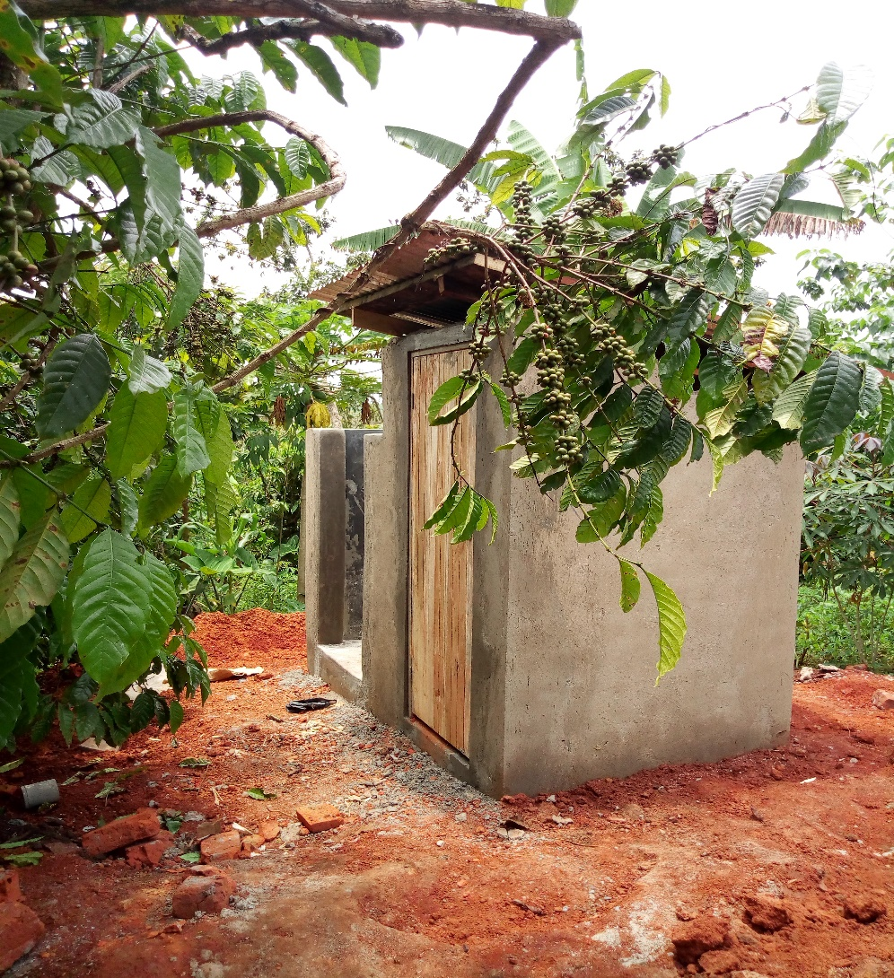
Health, water & sanitation
5 OVCs benefited from heath care. Comprehensive care is provided for those OVCs with chronic illnesses
For serious illnesses, BLCDF partners with health Centre's and professional experts for care.
BLCDF ensures that all children in their program are immunized according to the ministry of health requirements, tested for HIV right after enrollment, access ART treatment and virus is Suppressed through proper adherence.
2 Households were supported to build pit latrines & 1HH with shelter
Pictured is a pit latrine constructed for an OVC household

Slide 13
TOTAL NUMBER SERVED PER SUBCOUNTY
MAY-SEPTEMBER 2019/2020

Slide 14
Birth registration
HIV 90-90-90
Only 3% obtained certificates
Short comings
Budget was lower than actual costs
Majority caregivers without N. ID cards
Way forward
To include in budget
Encourage caregivers to register
Out of 383 OVCs & caregivers, 97% have known HIVs status.
2 children HIV+ are not suppressed.
1 Runaway child due to schizophrenia
Way forward
For all, we are working closely with paediatricians and experts in the field

Slide 15
FAMILY REINTERGRATIONS
ECONOMIC STRENGTHENING(igaS)
TARGET: Only 40 children in residential care. Current total is 60.
Shortcoming
High OVC Vulnerability due to abandonment & abuse.
TARGET
30 HHS. 22 benefitted but only 14 with IGAs.
Short comings
Dishonesty
Thieves
WAYFORWARD
WAYFORWARD
Strengthen tracing & follow up
Comprehensive Household approach in intervention
Establish a Foster care program
Re-evaluating the capital grant support system
Strengthening DWIBs

Slide 16
Way forward
Build more partnerships to strengthen referral systems.
Use OVC data for programming
Active involvement of local leaders at all levels of intervention
Establish a local foster care program

