Slide 1
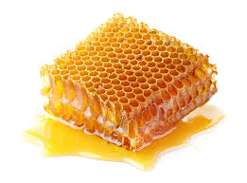
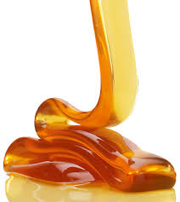
A
LECTURE
ON
APICULTURE
(Beekeeping)
Presented
by
O.ANDREW

Slide 2
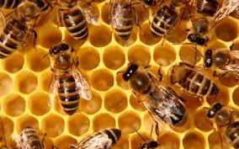
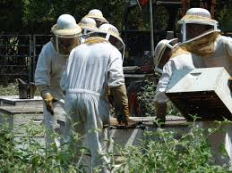
MODULES ON BEE KEEPING TRAINING FOR BEE FARMERS

Slide 3
INTRODUCTION TO APICULTURE
REQUIREMENTS OF APICULTURE
Definition of apiculture
Definition of bee keeping
Genesis of bee keeping
Kind of bee keeping
Manipulations of bees and other colony
Good record keeping
Locations of bees
Observation of bees/ behaviours
Possession of bee keeping equipment

Slide 4
SITE SELECTION
EQUIPMENT FOR REARING BEES AND MAINTENANCE
What to look for when sitting apiary
What to do to improvise condition for apiary
Acquiring knowledge how to move hive when necessary
Things not to be taking or present in the apiary
Preparation to site an apiary
Protective equipment
Management equipment
Harvesting equipment
Field equipment

Slide 5
METHODS OF REARING
SEASONAL CALENDAR IN BEE KEEPING
Tradition technique
Medium technique
High technique
Dearth season
Build-up season
Nectar-flow season
Honey-flow season

Slide 6
CLASSIFICATION OF BEES
ROUTINE MAINTENANCE
Organization of bees
Variation of bees
Characteristics of bees
Keeping hives on stands
Keep an extra hive
Keep a distance between hives
Keep record of activities on apiary

Slide 7
HARVESTING AND PROCESSING OF HONEY BEE PRODUCTS
PRODUCTS AND USES OF HONEY BEE PROJECT
Sign of honey ripe/ present
What to be put in place before harvesting
Things to be look for in a honey ripped hive
Things to be used for processing of honey and other products
Processing of the other product
Honey
Wax
Pollen
Propolis
Venom
Young bee
Hive air
Others

Slide 8
INTRODUCTION
Beekeeping also known as Apiculture is the rearing of the insect bee.
The main reason for beekeeping is to produce honey.
Bee honey is a natural sweetener easily digestible by children and adults.
It provides an incredible punch of vitamins, minerals, enzymes, proteins and amino acids.

Slide 9
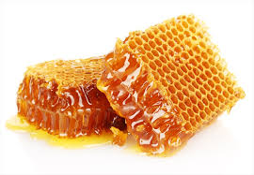
USES OF HONEY
Natural pure bee honey could be used for several curative purposes and it is highly recommended for those with various ailments such as:
asthma
boils
whitlows, burns,
cold/catarrh, severe coughs
gastric ulcer
hypertension, heart related diseases
Libido
menstrual problems, etc.

Slide 10
Honey is a readily tradable commodity and can realize cash with ease.
It is becoming more marketable for its medicinal and cosmetic properties.
Bee wax is a valuable by-product of honey production, used locally for making candles.
Propols or glue, a gum-like substance with medicinal value and anti-biotic properties is also a marketable commodity.

Slide 11
The greatest value of honey-glue lies in their capacity for plant pollination, thus, keeping bees can increase the fruit and seed production of many crops.
Bee pollen is increasing being regarded as a product in its own right and may be harvested from hives with the aid of pollen traps.
Its greatest value could be as a protein-rich food or local consumption.

Slide 12
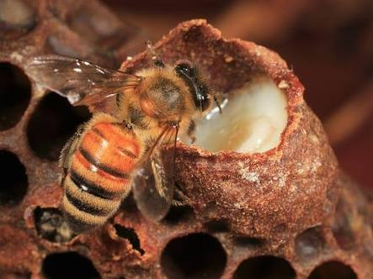
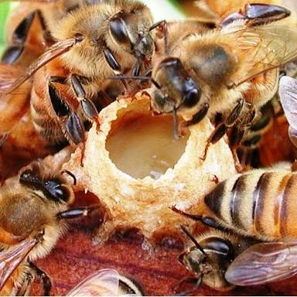
Royal jelly is a glandular secretion used by the bees to feed their larvae. The larvae of a queen bee is fed on royal jelly only.
Royal jelly can be collected from queen cells in the hive via a specialized operation and the jelly must be crop at all times.
Royal jelly is used in manufacturing expensive beauty products and sold as a specialized food product.

Slide 13
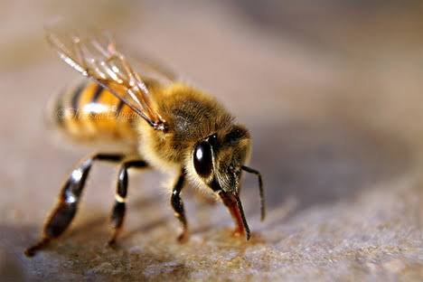
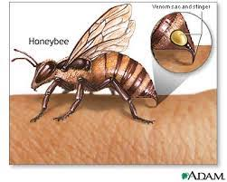
Bee venom can be collected by making the bees sting a latex rubber sheet stretched over a wooden frame.
It is used for medicinal purposes, sometimes to immunize people who have developed allergies to bee stings and sometimes for conditions related to arthritis.

Slide 14
The new technologies in modern beekeeping have made many people self-sufficient.
The business can be combined with other farming activities.
People are encouraged to own apiaries and derive maximum benefit from the venture because it is inexpensive to establish and highly rewarding economically.

Slide 15
GENERAL CONSIDERATIONS AND REQUIREMENT FOR APIARY/BEEKEEPING
CLIMATE AND FORAGE:
TYPE OF VEGETATION
Plants yield most nectar when it is neither too hot nor too cold.
To obtain a good honey crop, it is essential that there are periods when there is extensive flowering within 1km of the beehive.
Any areas that support vegetation- including urban areas can support bees.

Slide 16
MANIPULATION OF BEES AND THEIR COLONY
BEEHIVE
A beehive provides a suitable home for a colony of bees.
A well-designed hive will shelter the bees from adverse weather and pests and will allow the honey to be harvested with minimal disturbance to the bees.
Good hive design makes it easier to manage the bees and harvest the honey.
Honeybees exist either naturally or introduced by humans, in all but the most extreme environmental conditions.
Expertise and other resources are more readily available to offer ideal conditions for honey production.

Slide 17
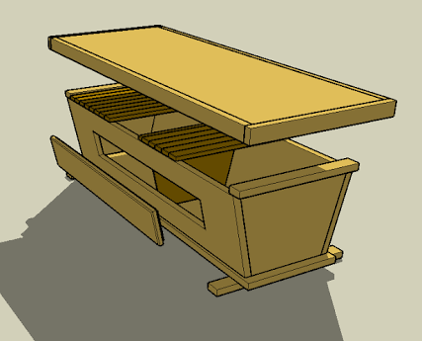
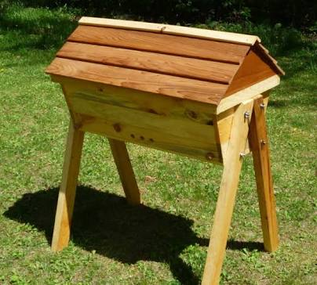
AVAILABILITY OF BEEKEEPING EQUIPMENT
Top-bar hives:
The Kenyan top-bar hive is a long hive normally made of timber and designed to take 28 top bars.
The most important part of a top-bar hive is the top bar itself. Top bars should be made from any reasonable quality wood that is well seasoned so that it does not warp. Hardwoods, if available, will last longer than softwoods.

Slide 18
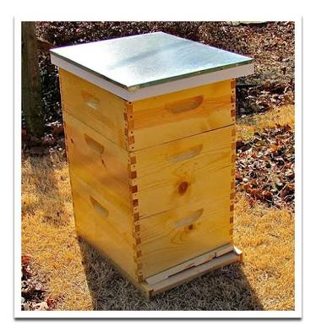
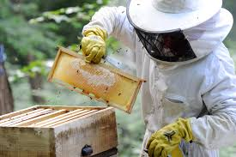
Langstroth:
Langstroth beehive is the house built for easy manipulation and easy management of the bees and bee colonies.

Slide 19
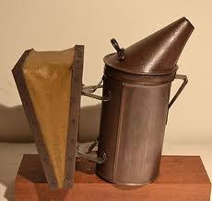
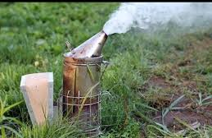
Smokers
A smoker is a device that enables the beekeeper to puff smoke into and around a beehive to drive bees out during harvest made from thin sheet metal formed into a firebox and attached to a pair of bellows.
The bellows pump air into a vent at the base of the firebox so that smoke is forced out of the funnel at the top of the smoker.

Slide 20
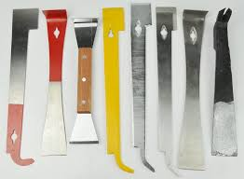
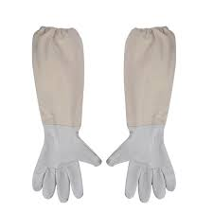
Hive tools
A hive tool is metal implement that is used to pry open a beehive and remove the lid, super and top bars.
Gloves
The best gloves are made from thin, soft smooth leather. Rubber gloves may be used but they are hot and uncomfortable and cause the hands sweat.

Slide 21
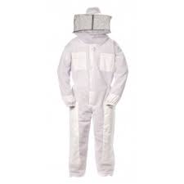
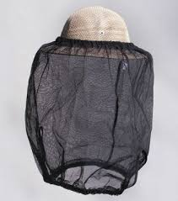
Bee suit
All –in-one overall make the best bee suits. Thick light coloured fabric.
Bee veil
This protects the face and can be made in several ways.
Sewing mosquito mesh directly onto a stiff straw hat with a wide brim is effective.

Slide 22
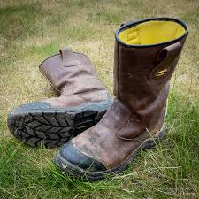
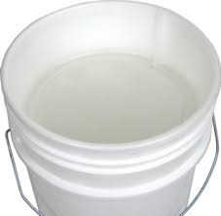
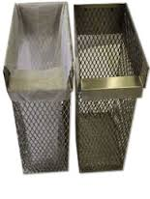
Footwear
Long bots and gum boots can be used.
Feet should be well protected by tucking the overalls in to the sturdy shoes.
Others: honey buckets, filter, storage containers and packages.

Slide 23
GOOD MANAGEMENT
Capital and operating costs are relatively low
Bees place no extra burden on the land
Bees improve production of many crops through pollination
Bees diversify the returns from mixed farm enterprise
The farmer is not dependent on a single crop
Bee products, properly prepared, will keep without depreciating for years, until consumed or sold

Slide 24
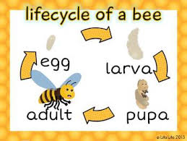
Good record keeping
Knowledge of life cycle of bees
Readiness to move bees from one place to another

Slide 25
INVESTMENT COSTS
Bee hives are materials used for housing the bees for honey production.
In traditional method, bees used local pots, baskets, gourd and hollow parts of trees as their hives.
Some of the modern hives in use today are langthroth hive and Kenyan top-bar hives.

Slide 26
Investment cost cont’d
A beehive costs between ₦10,000 - ₦20,000 depending on its size and height.
The capital investment depends on the scale of production (small, medium and large scales).
The materials are cheap and the technology can be easily practiced.

Slide 27
PROCESSING TECHNIQUE
Modern method of bee keeping involves the use of well constructed hives (boxes) making use of frames and top bars which are removable
to enhance multiplication of the bees within the colony and thereby ease the process of harvesting honey.
It is good to locate apiary very near citrus and mango.

Slide 28
PROCESSING AND PACKAGING OF HONEY
Honey is easy to process.
It does not require complicated machinery.
Hands could be used to press the honey on a small scale.
We can also engage the use of honey presser or extractor for the frames with combs.

Slide 29
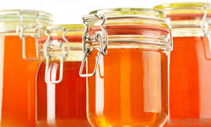
Processing and packaging cont’d
The honey so processed would be neatly collected and sieved with fine sieve of tiny mesh.
The honey could be packaged in bottles or plastic containers.

Slide 30
MARKETING/INCOME
Honey has long been one of man’s most highly desired food.
It has value for its sweetening properties coupled with medicinal value makes it a better substitute to sugar.
Honey has no side effects to health and the demand keeps increasing daily.
A beehive can produce as much as 20litres within three months.

Slide 31
Marketing/Income
If you have 10 beehives then you can produce about 200 litres of honey within few months.
A litre of honey sells for about ₦1,200.
This means that ₦240,000 could be realized from 200litres apart from the income that may be realized from other products like bee wax, royal jelly, bee venom and propolis.

Slide 32
Marketing/income cont’d
The initial invested capital could be realized from a single harvest.
If large quantity is produced, there are so many markets for it locally and internationally.

