Slide 1

GOOD DEEDS DAY EAST AND SOUTH AFRICA CONFERENCE HELD IN KENYA
PRESENTATION OF WESTERN –UGANDA BY MR. SUNDAY GEOFREY, ASSISTANT COORDINATOR GDD WESTERN UGANDA

Slide 2
APPRECIATION
In the first Place before our presentation, allow me to Kindly request you in your respective capacities , that Let us all jointly give a hand of applause to our CEO good deeds day international Mr. Kaynan Rabino for organizing and inviting us to this important conference especially when we have last for a longtime without meeting physically. It is due to his organizational preparations that we are here to discuss the urgent actions that we need to take and understand in promoting doing good in our respective countries or regions.

Slide 3
WHAT WE DID THIS YEAR 2022
A total of 71 ( seventy one organizations/CBOs/ institutions participated in good deeds this year in western and northern uganda, 2130 volunteers and 213 projects.
Committee meetings in October 2021 to plan and lay strategies of engaging stakeholders in promoting doing good in the region.
Engaged key stake holders in the region like government, CBOs, NGOs and other corporate institutions December 2021
Fundraising for good deeds activities in january 2022
Ti-shirts distrubution to partnering organisations march 2022
GDD events celebrations march/aprirl 2022.

Slide 4
CONT.of WHAT WE DID 2022
In promoting and celebrating doing good in our region, we looked at identifying the gaps in the community but in line with the 17 Global sustainable development goals and most of the projects/ activities that were done by GDD partners ranged among the following ,
Planting trees around river banks and in public places.
Hepatitis B tests and vaccination
Helped in feeding babies in babies homes.
Training communities on entrepreneurship and income generating activities.
Coffee agronomy trainings
Collecting gab badge around schools , hospital and markets
Visiting and counseling children in remand homes
Feeding and providing medical treatment to the people with disabilities.

Slide 5
CHALLENGES 2022
Out break of covid19 affected our working environment considering the low levels of ICT in the area.
High levels of poverty resulted into less engagement of GDD stake holders in our activities because most businesses collapsed due to covid 19. most individuals /institutions could not contribute to our volunteer GDD causes.
Majority of our GDD partners have not conceptualize the Idear of volunteerism of good deeds i.e Good deeds org. is not a donation organisation,it is promoting doing good in action.
Lack of institutional capacity development to GDD partner organisations.Organisations especially new ones need to know how to register on GDD portal during registration.Other organisations do not have sustainable funding.
The war out break in eastern DRC affected some activities in western uganda especially Kasese district .

Slide 6
PLANNS FOR 2023
GOAL: Ensuring a continued increament in CBO/Institutions participation in GDD promotional activities, projects and impacts in western Uganda by 2023.
2023 plan of activities.
Visiting refugees , fetch water, wash and cook for them.
Continued risk communication on covid 19 among communities.
Establish institutional gardens at people with disabilities schools to address malnutrition problems among people with disabilities in western Uganda.
We shall continue to promote the spirit of volunteerism with actions
Having two leadership capacity building training for committee leaders .
Identify few marginalized elders with poor housing conditions and volunteer to build for them houses.

Slide 7
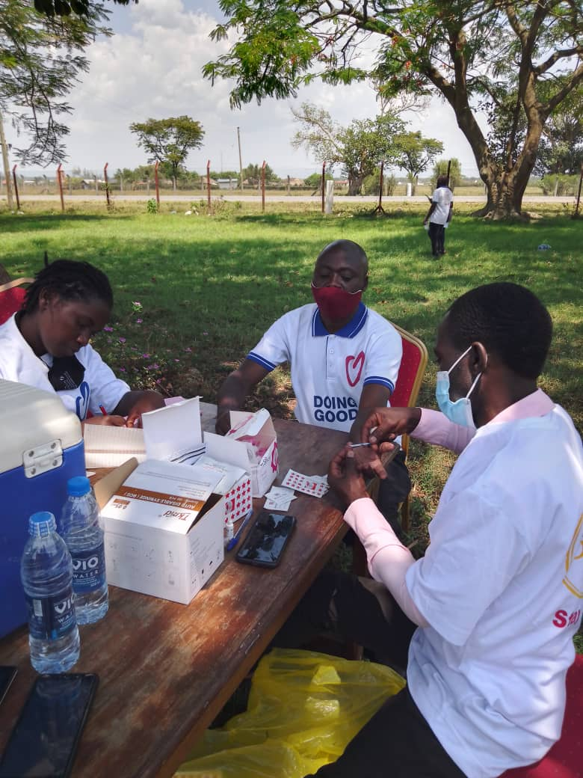
VACCINATION OF HIPETASISI B AT KASESE MULTIPURPOSE.

Slide 8
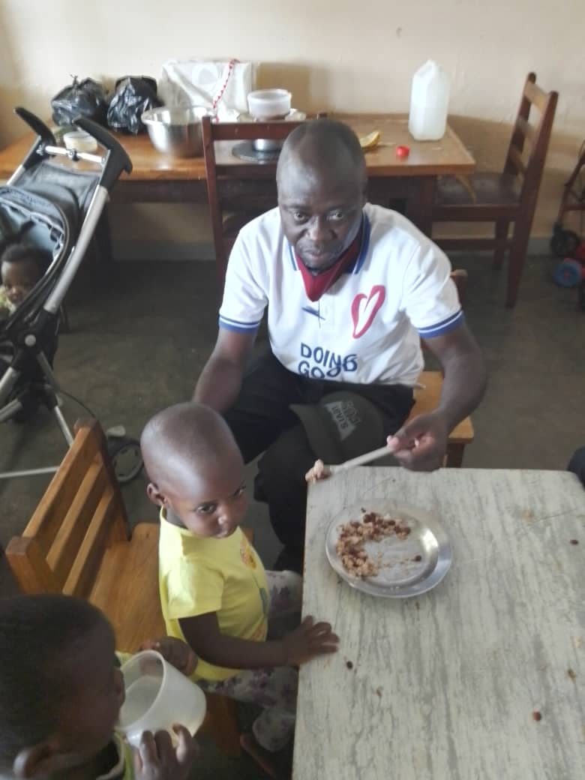
FEEDING CHILDREN AT TORO BABIES HOME.

Slide 9
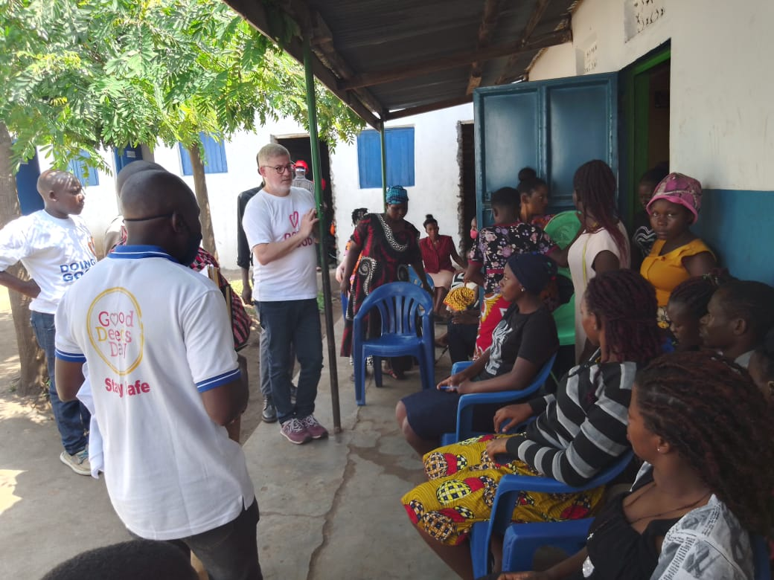
MENTORING PWDS ON HOW TO CREATE SELF EMPLOYMENT THROUGH VOCATIONAL TRAINING

Slide 10
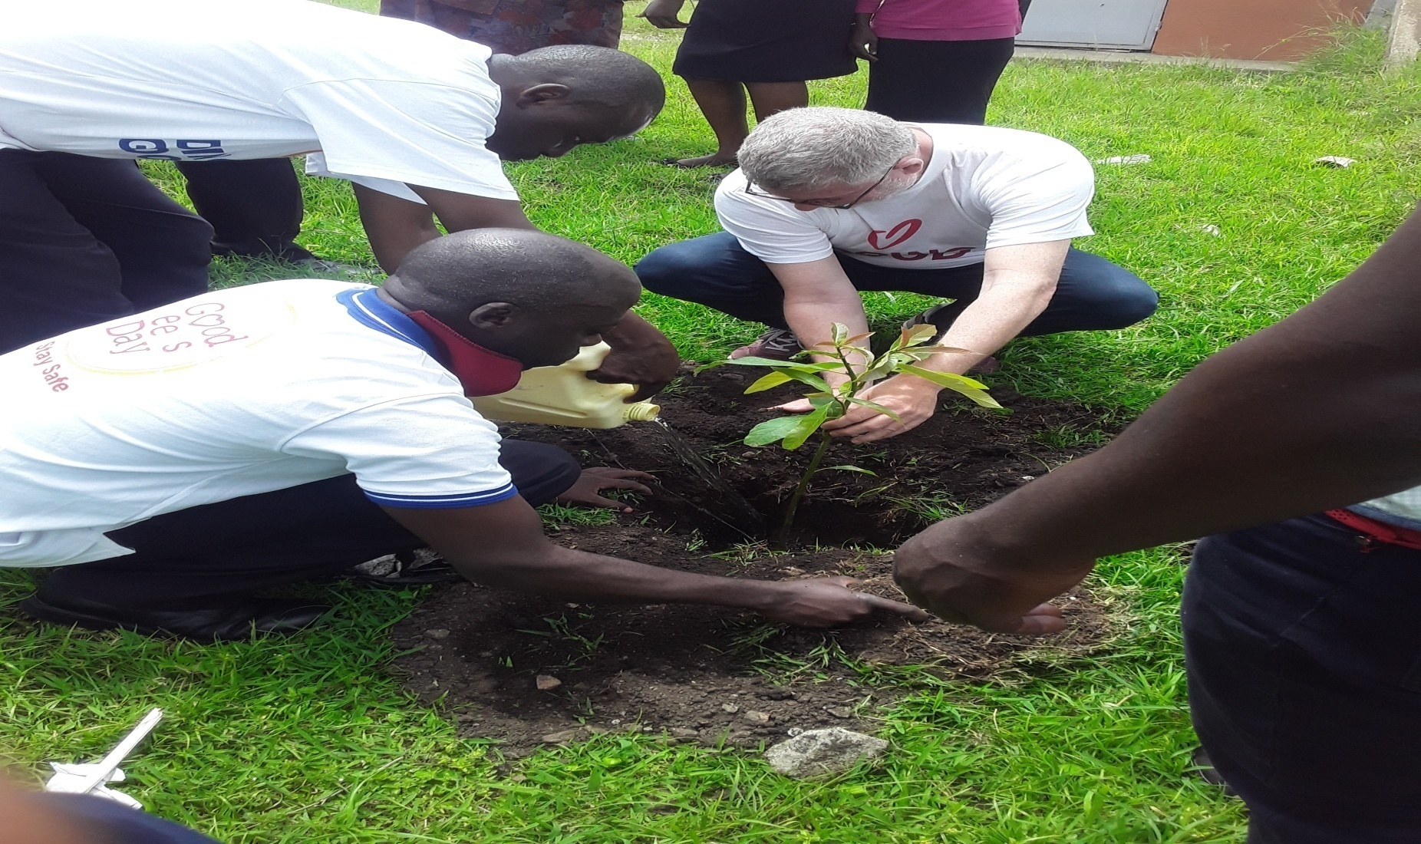
Tree planting at Kabarole youth center.

