Slide 1
WASAMA
WASAMA
SOLAR BOREHOLE FOR CONSISTENT CLEAN WATER SUPPLY AND IMPROVING LIVELIHOODS.
SHORA KAULUKA*(shorakauluka@yahoo.com 0888637445 BOX 2021 BT ), J.SINGINI
^{FOUNTAIN OF HOPE ORGANISATION}
INTRODUCTION
CONCLUSION
Unreliable rainfall pattern in Malawi has heavily affected the country’s economy because there is no consistent water supply. This has affected livelihoods where droughts, floods, Water scarcity, have been the topic of discussion every year. Agricultural production has been greatly affected as well due to either floods or droughts. This paper is a result of survey made at Chigumula farm in Blantyre on borehole effectiveness of reducing water scarcity while improving livelihoods through agricultural production throughout the year with consideration of mitigating and adapting to climate change effects. The farm of 10 hectares of land, relies on solar energy borehole which supplies clean water for both farm irrigation and drinking to 3000 people around the farm through taps. This borehole was dug 55 meters deep and other set of installations were made like 4 solar panels of 300 watts each, 10,000 litres’ tanks, taps just to mention a few. Water from the borehole has been supplied through taps to the fields as well as for the use of the communities.
The main objective of the action was achieved which was to assess the effectiveness of Solar energy borehole in relation to consistent water supply, social and economic resource, rural livelihoods and sustainable development. The technology is really effective through consistent water supply which is followed by other social factors advantages.
.Therefore, solar energy borehole is suitable for consistent Clean water supply and Improving livelihoods.
RECOMMENDATION
- The technology should be adopted especially in areas where disasters have been more recurring.
- The technology can be implemented at least, at each Area Development Committee Level.
-The technology can help reduce cases of cultivating in the river streams or along the river banks.
REFERENCES
OBJECTIVES
-CEPA (2008). Draft Analytical report and Policy elements on review of Climate Change and Disaster Risk Reduction Policy and Legal Framework in Malawi;
- Statistics from the Centre for Research on the Epidemiology of Disasters (CRED)
- National Water policy by GoM 2005
- Climate Change country profile for MW1
2014 – 2015 Seasonal Forecast by the Malawi Department of Climate Change and Meteorological Services
The main objective of the survey was to assess the effectiveness of Solar energy borehole in relation to consistent water supply, social and economic resource, rural livelihoods and sustainable development .
METHODOLOGY
Focus group discussions were conducted in 4 separate sessions of 25 participants each. individual interviews to community members and farm workers.
RESULTS
The study has revealed the following from the solar energy borehole farm project:
This technology is a: 1)Source of consistent water supply 2)Source of social and economic resource 3)Tool for sustainable development 4) Source of food security 5) Tool of Improving rural livelihoods 6) An Alternative solution to climate change impact like dry spell.7) Relevant to water supply, sanitation and hygiene.
ACKNOWLEDGEMENT
CHIGUMULA FARM STAFF
- CHITANI COMMUNITY SUSTAINABLE DEVELOPMENT ORGANISATION
-FOUNTAIN OF HOPE ORGANISATION TECHNICAL STAFF

Slide 2
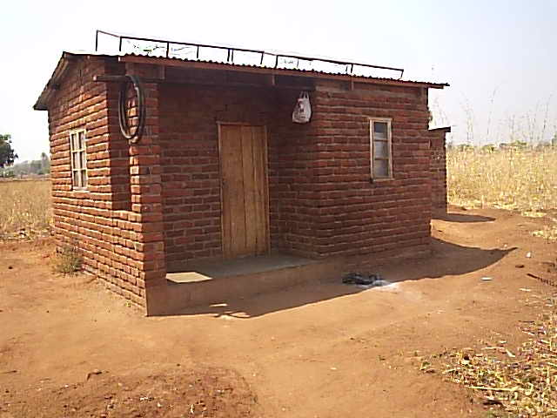
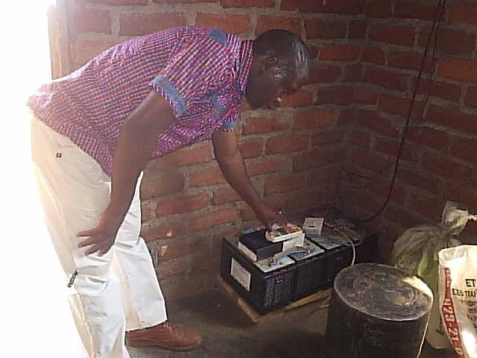
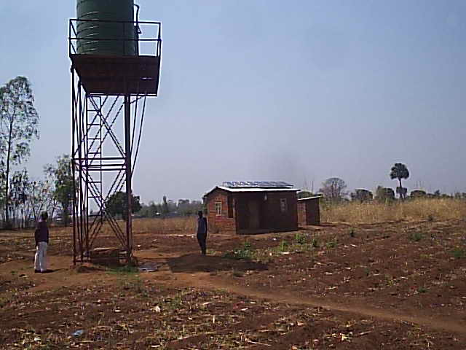
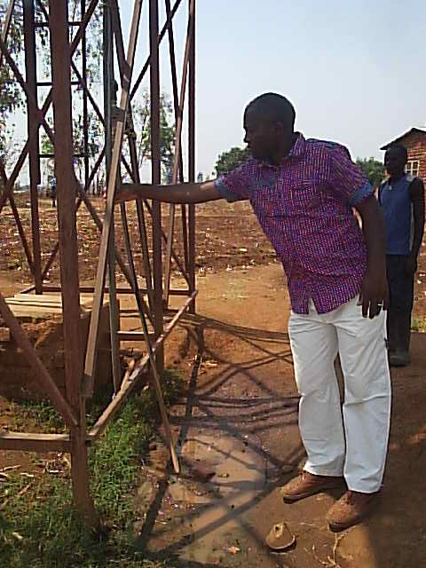
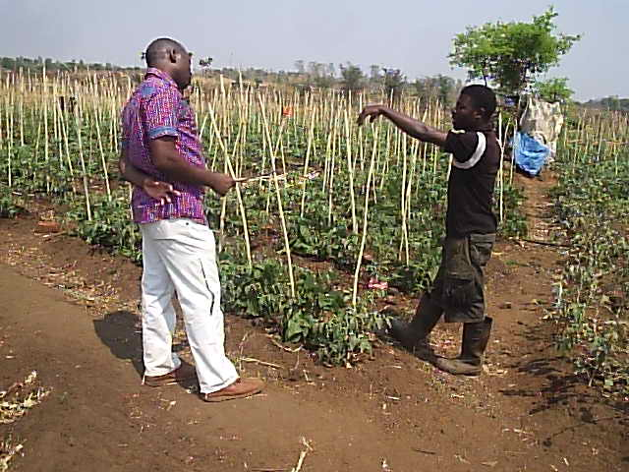
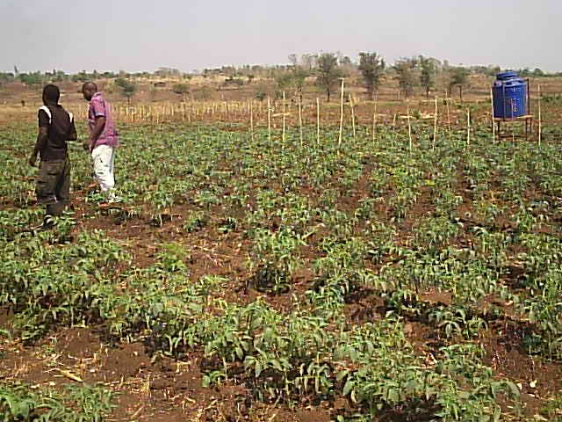
SOLAR BORE HOLE
PICTURES
A small house with solar panels on top of the roof and Batteries housed inside as shown on the right hand side.
A 10000 litres water tank was mounted on top of metal welded pillar (storey) which was installed where the borehole was dug 55 metres deep. Here there is an electron wire connected from the small house to inside the borehole water. The borehole was lined up with cement and covered with the slab.
v
A farm manager is explaining about how the farm operates and how people are benefiting from this farm. Other smaller tanks are also installed inside the field as seen on the right.
There is apipe inside the borehole that takes water to the tank before being opened for supply.

