Slide 1

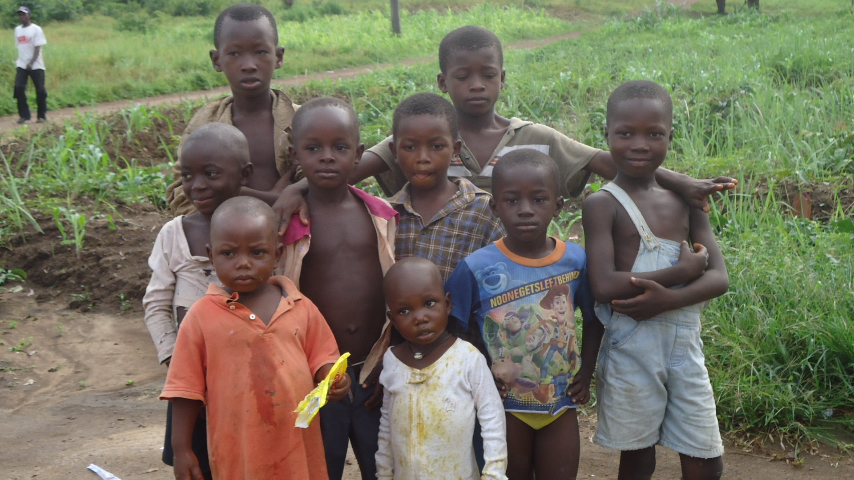
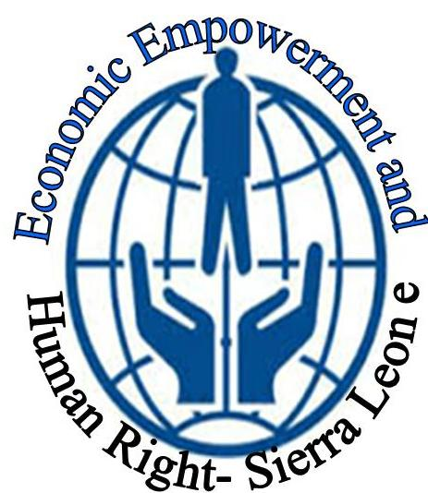
ECONOMIC EMPOWERMENT AND HUMAN RIGHTS SIERRA LEONE
1Fetter lane London EC4A 1BR
Tel. +442034273858
COMMERCIAL OFFER
Building Communities Together

Slide 2
About Organisation
Economic Empowerment and Human Rights-Sierra Leone is an indigenous initiative non-religious, non-political and non-governmental organization that is Centered on the promotion and protection of Women and Children in rural communities in Sierra Leone, and as well as the involvement of Communities in Development, Democracy and Human Rights, With special focus on the International Convenient on Economic, Social and Cultural Rights. It was founded in 2010 and registered with the Ministry of Social Welfare, Gender and Children’s affairs, itshas it headquarter in Sierra Leone and has official representation offices in Bombali, Tonkolili, Bo, Kono and Port Loko Districts.
works on Human Rights, women access to land/property, Food Security, Early Child Marriage, Economic Empowerment and healthcare for over 5 years and has extensive experience in advocacy, sensitisation, community engagement, Dialogue and outreach activities. We have the full potential for implementation of international projects.
EEHRSL
EEHRSL

Slide 3
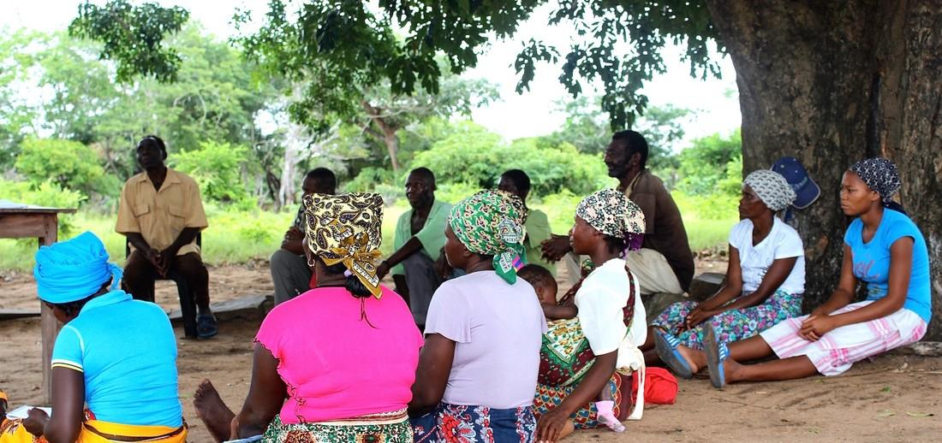
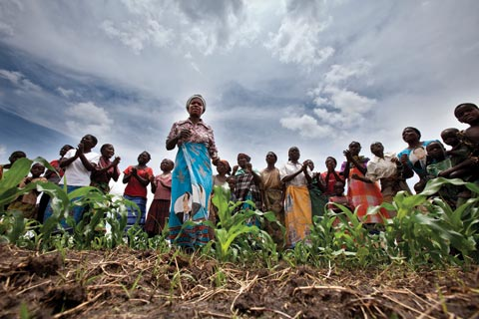
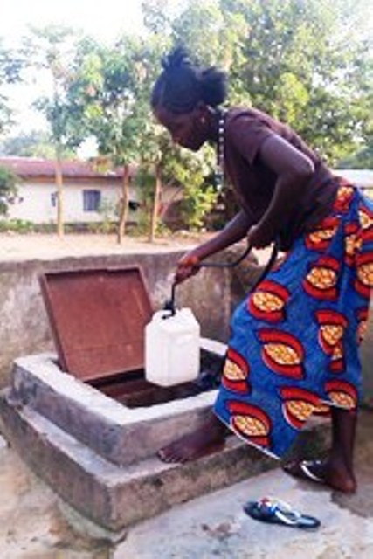
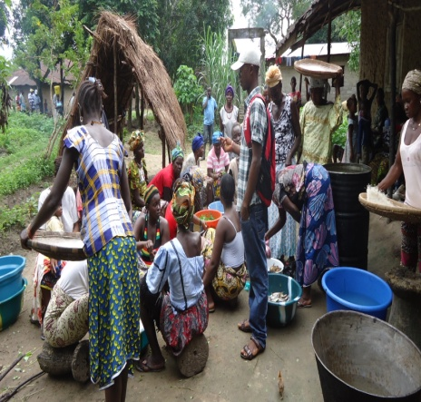
Activities of the Organization
Early Child Marriage campaign.
Sensitization Campaign on Ebola.
Women and the poor Access to Land Rights.
Water wells Construction.
Community Education.
Family livelihood Support
Gender Empowerment.
Human Rights Education and more

Slide 4
Organization Experience
We have ongoing projects in all our operational Districts in Sierra Leone of Bombali, Tonkolili, Bo, Kono and Port Loko.
—Bombali District
— Tonkolili District
— Bo District
— Port Loko District
- Kono District
The projects in progress
Family livelihood support
Human Rights Education
Health Care (HIV/AIDs)
Women and poor Land Rights awareness campaign
Agriculture project for 5 women’s groups, Child Marriage
Ebola Food Supply to Quarantined Homes and Survivors, Child Marriage
Early Child Marriage, Stop Child Labour project

Slide 5
What We Do
Our organization can implement projects on development, Human Rights, Community Empowerment and Women Economic Empowerment. We use the following strategies to achieved the above approaches:
Information on human rights education/documentation.
Trainings, campaigns awareness, public education.
monitoring of legal institutions-police stations, courts, prisons and local detention facilities .
Community education.
Provide legal information to suspects and accused persons.
Advocacy and Monitoring.

Slide 6
EEHRSL-Gender empowerment.
Our experience working with gender issues has shown that addressing gender equality and women’s empowerment requires strategic interventions at all levels of programming and policy-making
The Main Issues the EEHRSL Encounters:
Reproductive health: Women, for both physiological and social reasons, are more vulnerable than men to reproductive health problems. Reproductive health problems, including maternal mortality represent a major cause of death and disability for women in developing countries.
Natural resources: Women in Sierra Leone are usually in charge of securing water, food and finances. Therefore, they tend to put into immediate practice whatever they learn about nutrition and preserving the environment and natural resources
Political empowerment: Political empowerment: Social and legal institutions still do not guarantee women equality in basic legal and human rights, access to legal empowerment control of land/property still remains an unanswered questions for men, equality in employment, social and political participation, Even when women are in parliament and or in governance they are still answerable to men for continuity of their position.
Educational empowerment: About two thirds of the illiterate adults in Sierra Leone and in the world are female. Higher levels of women's education are strongly associated with both lower infant mortality and lower fertility, as well as with higher levels of education and economic opportunity for their children.

Slide 7
Women Access to Land
Sierra Leone has a dual land tenure system, with aspects from the colonial era and customary ownership varying in proportion, depending on location. This creates confusion regarding land rights for women.
Activities:
Community Engagement (Paramount chiefs and Stakeholders).
Community Meeting/Dialogue.
Advocacy and Monitoring.
Institutional Engagement.
Trainings, Workshops and Conferences.
Legal Empowerment (Paralegal Services).

Slide 8
HOW DO EEHRSL MAKE A DIFFERENCE?
Activities
Monitoring and advocacy
Direct lobbying (informal and formal contacts).
Building strategic coalitions (different levels from community to international).
Mobilising public support (use of media, Community engagements, demonstrations).
Research/collecting information as a basis for monitoring and advocacy.
Innovation, capacity building and service provision
Housing and credit programmes.
Conflict resolution methods.
Participatory methods.
Registration of community lands.
Group formation/leadership training.
Channelling requests for support from communities.
Information and training on land and housing issues.
ROLES AND ACTIVITIES

Slide 9
EEHRSL FUNCTIONARIES
Board of Directors: The Board comprises of five members, two (2) men and three (3) reputable women, and they are appointed by the General membership of the organization for a period of three years at a time. The Board approves decisions, assists in raising funds, policies and provides directions made by the EEHRSL membership and its staff.
Staffs: we have 6 permanent staffs, they includes:
Executive Director.
Director of Programs.
Finance Manager.
Gender Desk Officer.
Media and communication.
Project Officer.
Volunteer: The volunteers are group of young men and women in Sierra Leone who constitutes the general membership of the organization. They provide free voluntarily services and are giving stipends at the end of every month. They also play a major role in making decisions, and monitor every project under implementation by the organization.
Interns: our Internship recruitment is opened to nationals and non-nationals. especial people who have interest in women and children’s rights issues.

Slide 10
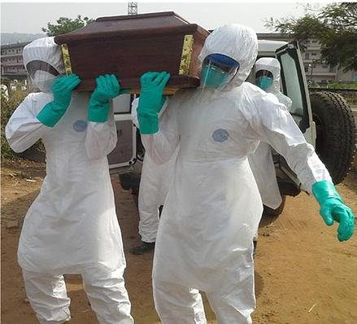
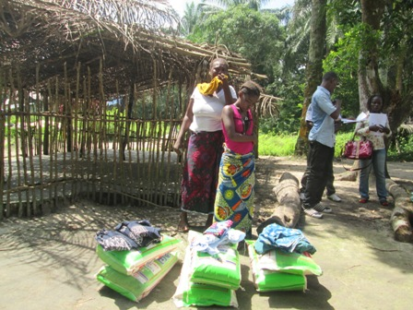
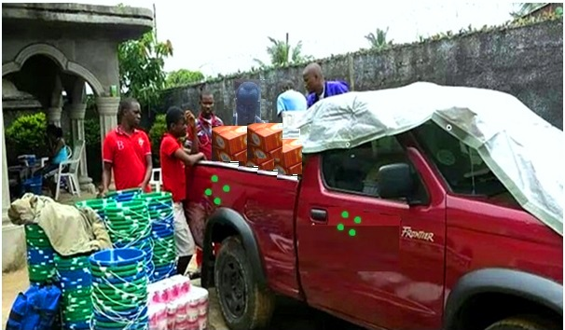
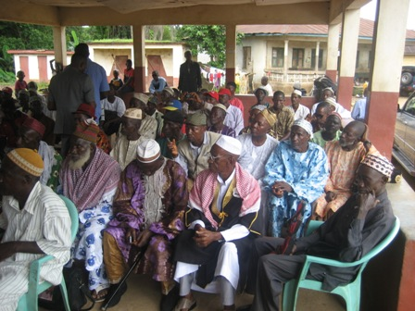
Emergency Ebola Responds in Sierra Leone
Ebola is a viral disease that is transmitted from animals to human, very few people affected by the disease will be lucky to survive. In fact, scientist have estimated that the disease has 90% chance of killing it’s victims, whilst others claim it has no cure.
Our Activities:
Community Awareness Campaign.
Radio/TV discussion programs on the preventions of Ebola.
Community Engagement (paramount chiefs, Traditional healers and stakeholders).
Food Supplies to quarantine homes and Child orphans.
Supply of Ebola Preventive Materials to Communities.
Training of contact tracers, Health workers, volunteers and community Focal persons.
Skill Training for Adult Survivors and Educational support for Child Survivors.

Slide 11
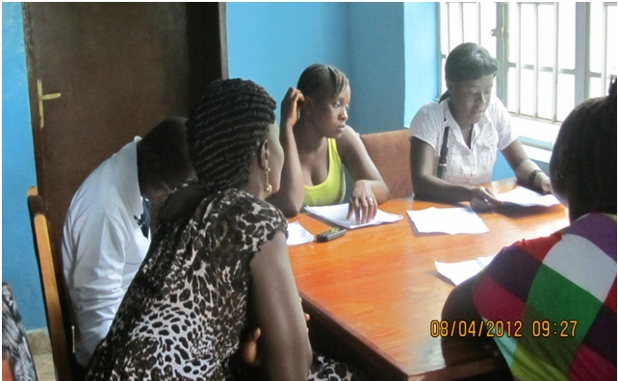
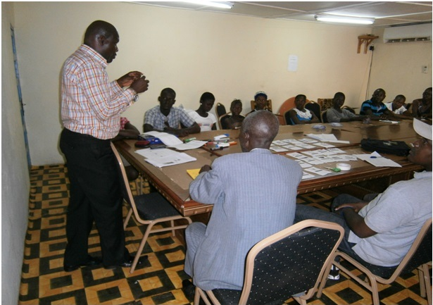
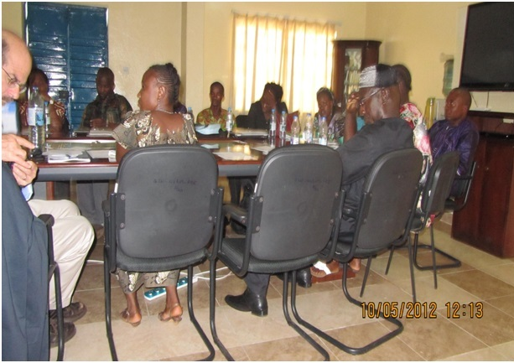
Staff Training and Capacity Building
Training
Training of Staffs and Capacity building has being one of our major challenge from 2014 to 2015 due to the Ebola out break, we have not been able to secure funding for this sector. Not withstanding this, we have a wide range of experience staffs in community mobilization, advocacy, sensitization, and outreach activities. EEHRSL has trained and qualified staffs to carried out project Implementation with qualification ranging from Diploma to Masters Degree

Slide 12
Our Partners
Economic Empowerment and Human Rights-Sierra Leone is partnering with developmental agencies both national and international
Our national Partners
Ministry of Social welfare Gender and Children’s
Ministry of Agriculture and food security.
Five daughters Sierra Leone
Child Help sierra Leone
Help a need child
Young Ambassador
District Councils
Needy child Salone
District Human Rights Committees
Our International partners
Girls Not Brides International- UK
Help a child in Africa-Uganda
Yegesie International Open Collage of Technology
Global Hand International- UK
Humanity Worldwide- USA
Global Giving-UK
Global Council for Women
Landesea-India

